Slide 1
Objects Oriented Programming using C++
Layne Pedersen
layne.pedersen@usu.edu

Slide 2
Objects
What are objects?
Groups of data and modifiers in memory
  i.e. data and methods

Slide 3
Example
A collection of doubles
Sum of N integers
  Input: N integers
  Output: summation of each integer
Matrix multiplication
  Input: two matrices
  Output: product of two matrices

Slide 4
Objects in c++
structs
  default access is public
  cannot use templates
unions
classes
  default access is private

Slide 5
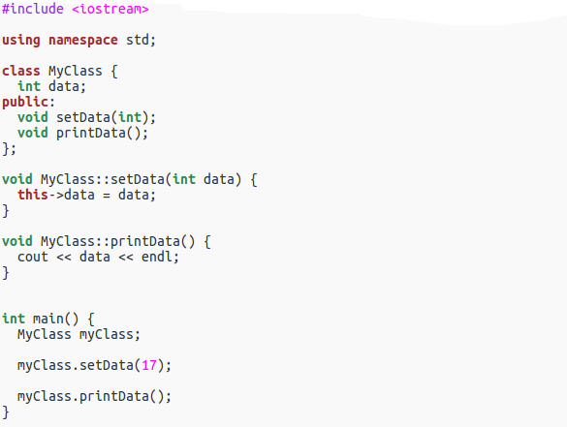
C++ Classes

Slide 6
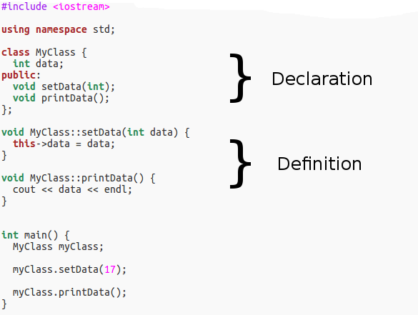
C++ Classes

Slide 7
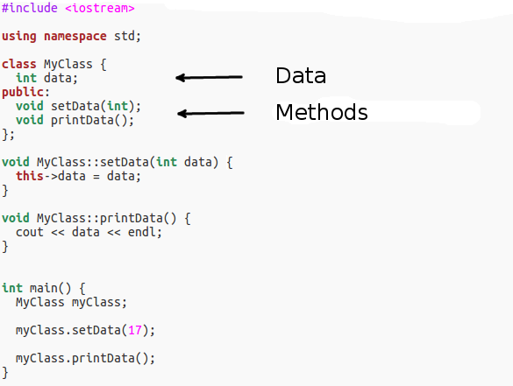
C++ Classes

Slide 8
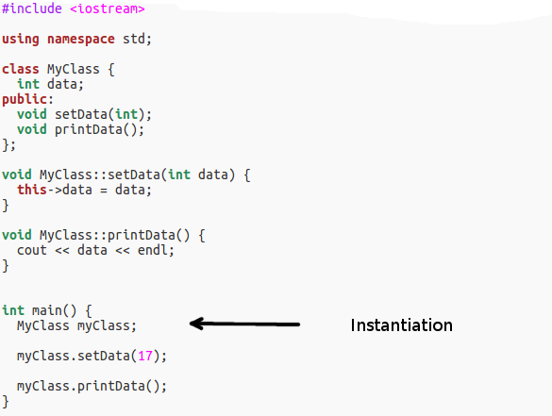
C++ Classes

Slide 9
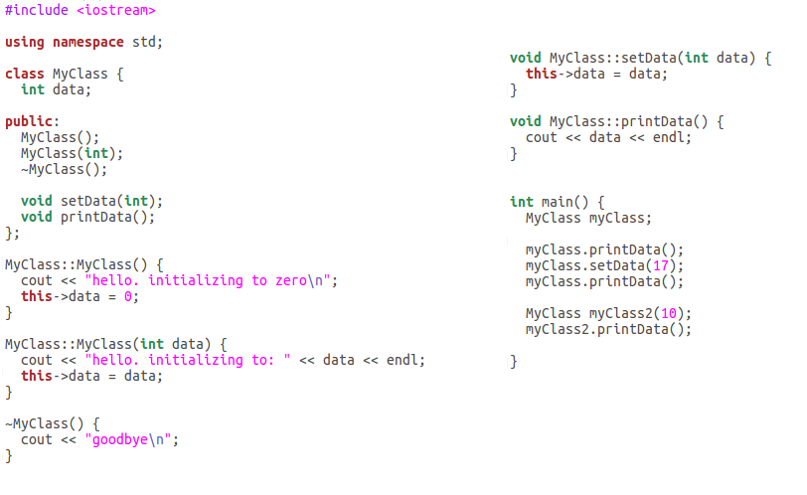
Constructors and Destructors

Slide 10
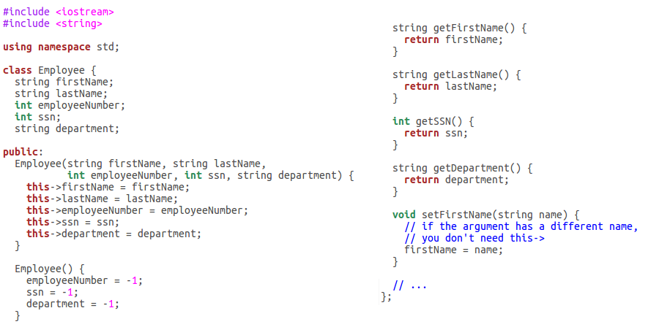
Encapsulation

Slide 11
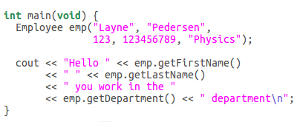
Encapsulation

Slide 12
Pointers
Special variables the “point” to another variable, object or NULL
The value of a pointer variable is the address of the variable or object to which it points
Pointers are very convenient and powerful but may will lead to bugs that are difficult to find
Some languages like Java have compile-time checking to try to eliminate these kinds of bugs

Slide 13
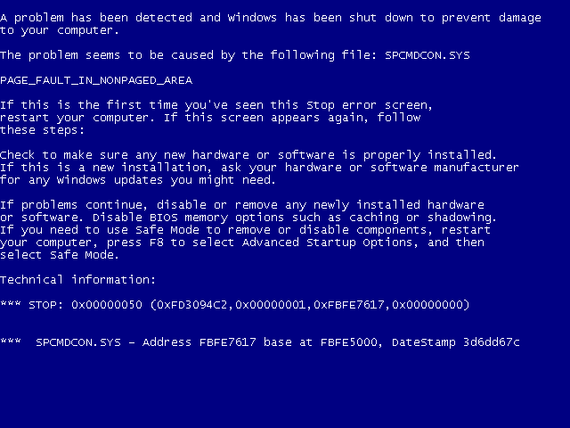
Pointers: BSOD

Slide 14
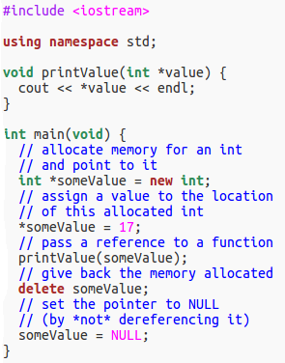
Pointers
passing a pointer
  this is called passing by reference
dereferencing a pointer
  assigning or retrieving the value of the variable that the pointer points to

Slide 15
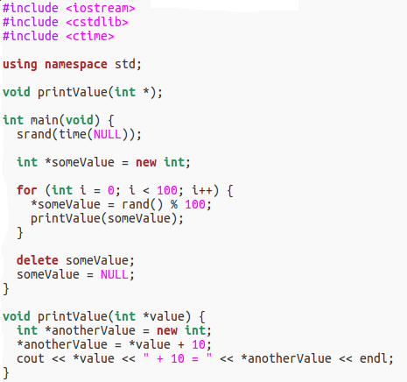
Pointers: what's wrong with this code? (memory leak)

Slide 16
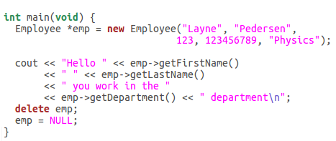
Pointers to objects

Slide 17
Inheritence
Write an Animal class
Add data that describe a generic animal
  Sound
  Name
  color
  etc
Add a constructor that will populate this data
Add a print method that will tell us about the animal on the console

Slide 18
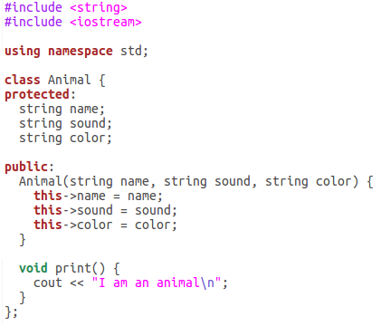
Inheritence

Slide 19
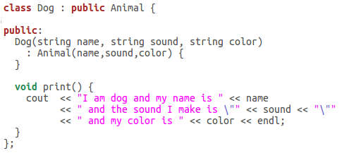
Inheritence: derived classes

Slide 20
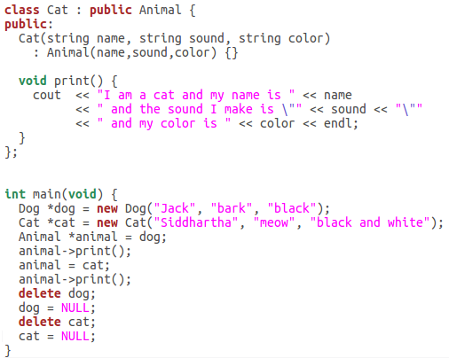
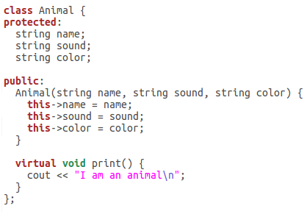
Polymorphism

Slide 21
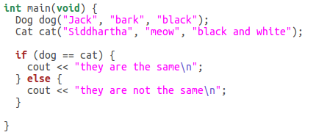
What happens when we operate on two objects?

Slide 22
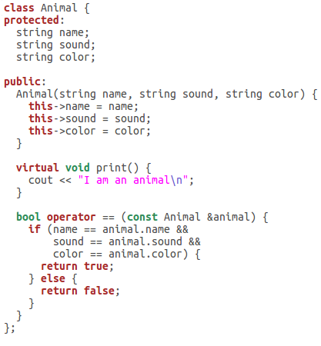
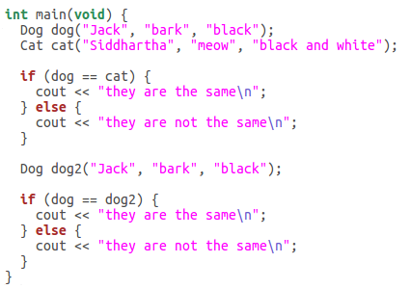
Operator overloading

Slide 23
Operator overloading
Copy constructor
=,+,-,*,+=,-=,*=,==,!=,<<,>>,[],etc
You must override any operator that is relevant to your object

Slide 24
Templates
Standard Template Library

Slide 25
additional libraries
libboost

